Slide 1
SJOGREN’S DISEASE (SjD) AND MIGRAINE:
An Interface of
Autoimmunity and Neurovascular Systems
___________________________________________________

Slide 2

I apologize that I cannot be there in person to see many old friends and meet the next generation of SjD leaders
__________________________
(This may be the first SjD Foundation meeting that I have missed s since the initial meeting held 1986 in Copenhagen)
Robert I. Fox, M.D., Ph.D.
C
C
Scripps Memorial Hospital
and Research Foundation – Xi-Med
La Jolla (San Diego), California USA
robertfoxmd@icloud.com
Medical and PPt Layout Editor: Carla Fox, R.N.

Slide 3
Take Home Points - 1:
__________________________
Recognize a high prevalence of migraine in Sjogren’s Disease (SjD)
patients.
Should we consider migraine a neurologic feature of SjD?
(although controversial in SLE, it is a feature of the SLEDAI).

Slide 4
Take Home Points – 2: __________________________
Migraine headache (with or without SjD) is a major factor that impacts the patient’s Quality of Life.
Careful observation of both migraine data in SjD trials and SjD data in migraine trials may help us understand both disorders.
We are setting up templates for EPIC (electronic medical records) to include neurologic manifestations of SjD, as we do not want to miss the opportunity to include these symptoms and medications.

Slide 5
There are two important neurokine targets that have emerged from migraine studies
__________________________
Calcitonin related gene peptide”—CRPG
Pituitary Adenylate cyclase associated peptide –PACAP
These may be relevant in SjD, and will be discussed in this talk.
I will defer details of these molecules, but you may submit any inquires to me using my email address – RobertFoxMD@icloud.com

Slide 6
Take Home Points -3:
Success in understanding migraines may help develop new therapies for SjD patients
__________________________
CRGP (Calcitonin Related Group Peptide) is released from the trigeminal nerve and ganglion, causesing long-acting vasodilation of small arterial capillaries in the brain, resulting in migraine headache.
CRGP is released into nociceptor C-fibers elsewhere in the body, including those in the salivary and lacrimal glands.

Slide 7
“CGRP”- Calcitonin Related
Group Peptides
__________________________
The name “CRGP” reflects the origin of this peptide from “alternative splicing” that produces a 38-amino acid peptide from the calcitonin gene.
There are two isoforms of CGRP (α-GCRP and β−CGRP). The main isoform present in the trigemino-vascular system and brain is the α-GCRP

Slide 8
The role of T-cells and autoantibodies is unclear in migraine
__________________________
T-cells have CRGP receptors and may produce either pro- or anti-inflammatory cytokines upon stimulation.
However, changes in circulating cytokines in either blood or CSF of patients during migraine are small, and their significance is questionable
This emphasizes our future need to focus the role of T-cells other than cytokines in networks involving the dryness and fatigue of SjD

Slide 9
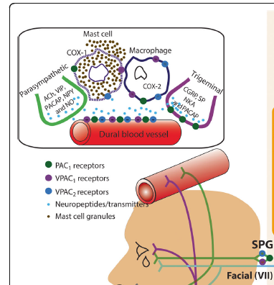
The initial target appears to a specific region of dural blood vessel in a peripheral nerve (VII):
a. autoinflammatory
such as degranulation of mast cells
b. innate receptor to
cytokine or neurokine
c. antibody driven
from gut-immune axis

Slide 10
The next key player is CGRP
This vasodilatory neuropeptide is derived by alternative splicing of the calcitonin gene
The pink “exon” is the active peptide responsible for the vasodilation

Slide 11
CGRP is released from nerves, binds to arterial smooth muscle, causes neurogenic vasodilation and then diffuses across the blood-brain barrier to cause headache
Blood-Brain Barrier

Slide 12
The inhibition of CGRP action has revolutionized the treatment of Migraine
_______________________
Monoclonal antibodies against
CGRP ligand or it’s receptor
Small molecules CGRP Receptor antagonist
Large molecules, SQ or IV
Amovig (Erenumab),
Emgality (Galcanezumab)
Ajovy (Fremanezumab)
Vyepti (Eptinezumab)
ORAL
Nurtec (Rimegepant )
Ubrelvy (Ubrogepant )
Qulipta (Atogepant )

Slide 13
Parasympathetic Vasodilation enhanced by CGRP and SP
__________________________
CGRP is released from same vesicle that contains Substance P (SP).
SP causes brief vasodilation, but considerable plasma extravasation.
In stimulating tear or saliva flow,
the parasympathetic stimulation of Muscarinic Receptor M3R leads to activated gland function
CGRP leads to extended vaso-dilation of blood vessels
Increase in plasma extravasation due to SP and VIP

Slide 14
Take Home Points – 4:
Different nerves store different vasoactive neurokines.
__________________________
  Parasympathetic fibers release acetylcholine (Ach) and vasoactive intestinal peptide (VIP).
  Sympathetic fibers release noradrenaline and neuropeptide Y.
  Sensory afferent fibers release CGRP, substance P and neuropeptide Y.

Slide 15
CGRP, Substance P and VIP are in Salivary and Lacrimal Glands
__________________________
These neuropeptides serve as co-transmitters with acetylcholine and noradrenaline.
Neurokine effects are longer-acting than parasympathetic muscarinic stimulation.
Neurokine release require more intense nerve stimulation for release.
The inflammatory milieu in SjD glands may interfere with neurokine release and the vasodilation required for tear or saliva flow.

Slide 16
Take Home Points – 5:
Another important target identified in migraine is
Pituitary Adenylate Cyclase-Activating Polypeptide (PACAP)
_________________________
PACAP is widely distributed: it is found in the peripheral and central nervous systems, as well as in exocrine and endocrine tissues in the respiratory, gastrointestinal, endocrine and reproductive systems.
PACAP located in areas associated with migraine pathophysiology, specifically the paraventricular nucleus of the hypothalamus, trigeminal nucleus caudalis, and the trigeminal ganglion.
:

Slide 17
Trigemino-cervical neurons responding to a trigemino-vascular nociceptive stimulus are modulated by
PACAP-based mechanisms
__________________________
PACP reduces pain threshold to nociceptive stimuli and makes even mild stimulation more painful.
Thus, PACP may contribute to amplifying pain signals from dry eyes and dry mouth.

Slide 18
PACAP and VIP share the same receptors
________________________________________

Slide 19
Take Home Points – 6:
Possible PACP role in symptoms in SjD:
__________________________
PACP has been shown to mediate memory and learning problems in response to stressors in patients with PTSD - (post-traumatic stress disorder).
The correlation of objective dryness of eyes/mouth with patient reported symptoms is very poor in SjD.
  This may be due to amplification of nocioceptive signals due to lower pain threshold.
It also may play a role in the amplification of myalgia or arthritis resulting in “fibromyalgia” symptoms.

Slide 20
Migraine in SjD Patients
__________________________
Rheumatologists rarely consider migraine as an autoimmune manifestation of Sjogren’s Disease –
and we just refer the patient the neurologist or neuro-ophthalmologist…
But the association of SjD and migraine
has been recognized for many years
with initial report by the famous rheumatologist W.C. Dick in 1989.

Slide 21
“A Study of Headaches and Migraine in SjD”
__________________________
W.C. Dick et al
(Ann Rheum Dis. 1989;48:312)
Migraine was diagnosed in:
46% of SjD patients,
30% of Scleroderma patients
12% of RA patients,
11% of controls.

Slide 22
And more recently by Hadjev (2008) in the Scandanavian cohort
“Headache in primary Sjögren’s Disease: a Prevalence Study”
Acta Neurologica Scandinavica /
Volume 118, Issue 3 / p. 189-192
__________________________
In 133 of the primary SjD patients evaluated…
104 had headache.
There was no increase in migraine in RA patients.
No association was noted with the clinical and laboratory manifestations of the Sjogren’s Disease.

Slide 23
Back to SjD …
__________________________
The production of saliva or tears requires:
“Water and proteins” derived from the small arterioles;
Innervation of the glands to pump the fluid from the blood vessel to the lumen of the duct.
-- Inflammation of the micro-environment can paralyze this process.
-- Release of metalloproteinases can injure surface receptors.

Slide 24
Even in patients with longstanding SjD the gland is NOT totally destroyed … and almost 50% of the ducts and acini remain visible.
This leads to assumption that the innervation of the gland is impaired.

Slide 25
Parasympathetic
Fibers (acetylcholine
And VIP)
Sensory afferents
(GCRC and SP)
Receptor for
Muscarinic M3 and
CGRP (and others)
are also present

Slide 26
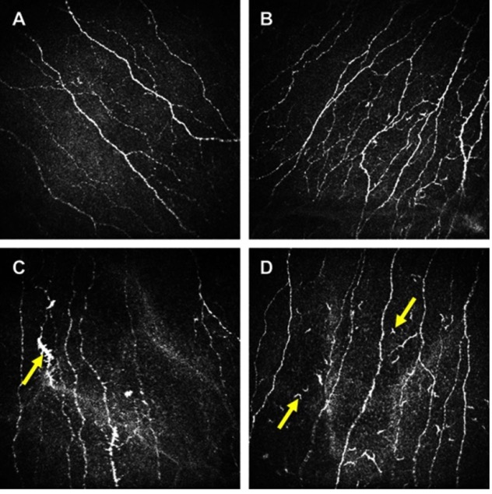
Confocal microscopy show similar changes in both SjD or
Migraine patients…
__________________________
NORMAL Control
Sjogren
A. Normal (control)
B. SjD patient (tortuosity)
C. Migraine (tortuosity);
D. Langerhans cells
(in the SjD patient)
Migraine
J Pain Res. 2019; 12: 1489–1495. PMCID: PMC6526177
Published online 2019 May 13. doi: 10.2147/JPR.S196705 PMID: 31190959

Slide 27
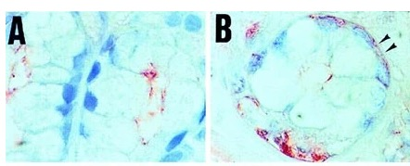
Although acini and ducts are present, they appear “non-functional” as shown by their disoriented aquaporin molecules.
__________________________
normal
SjD biopsy

Slide 28
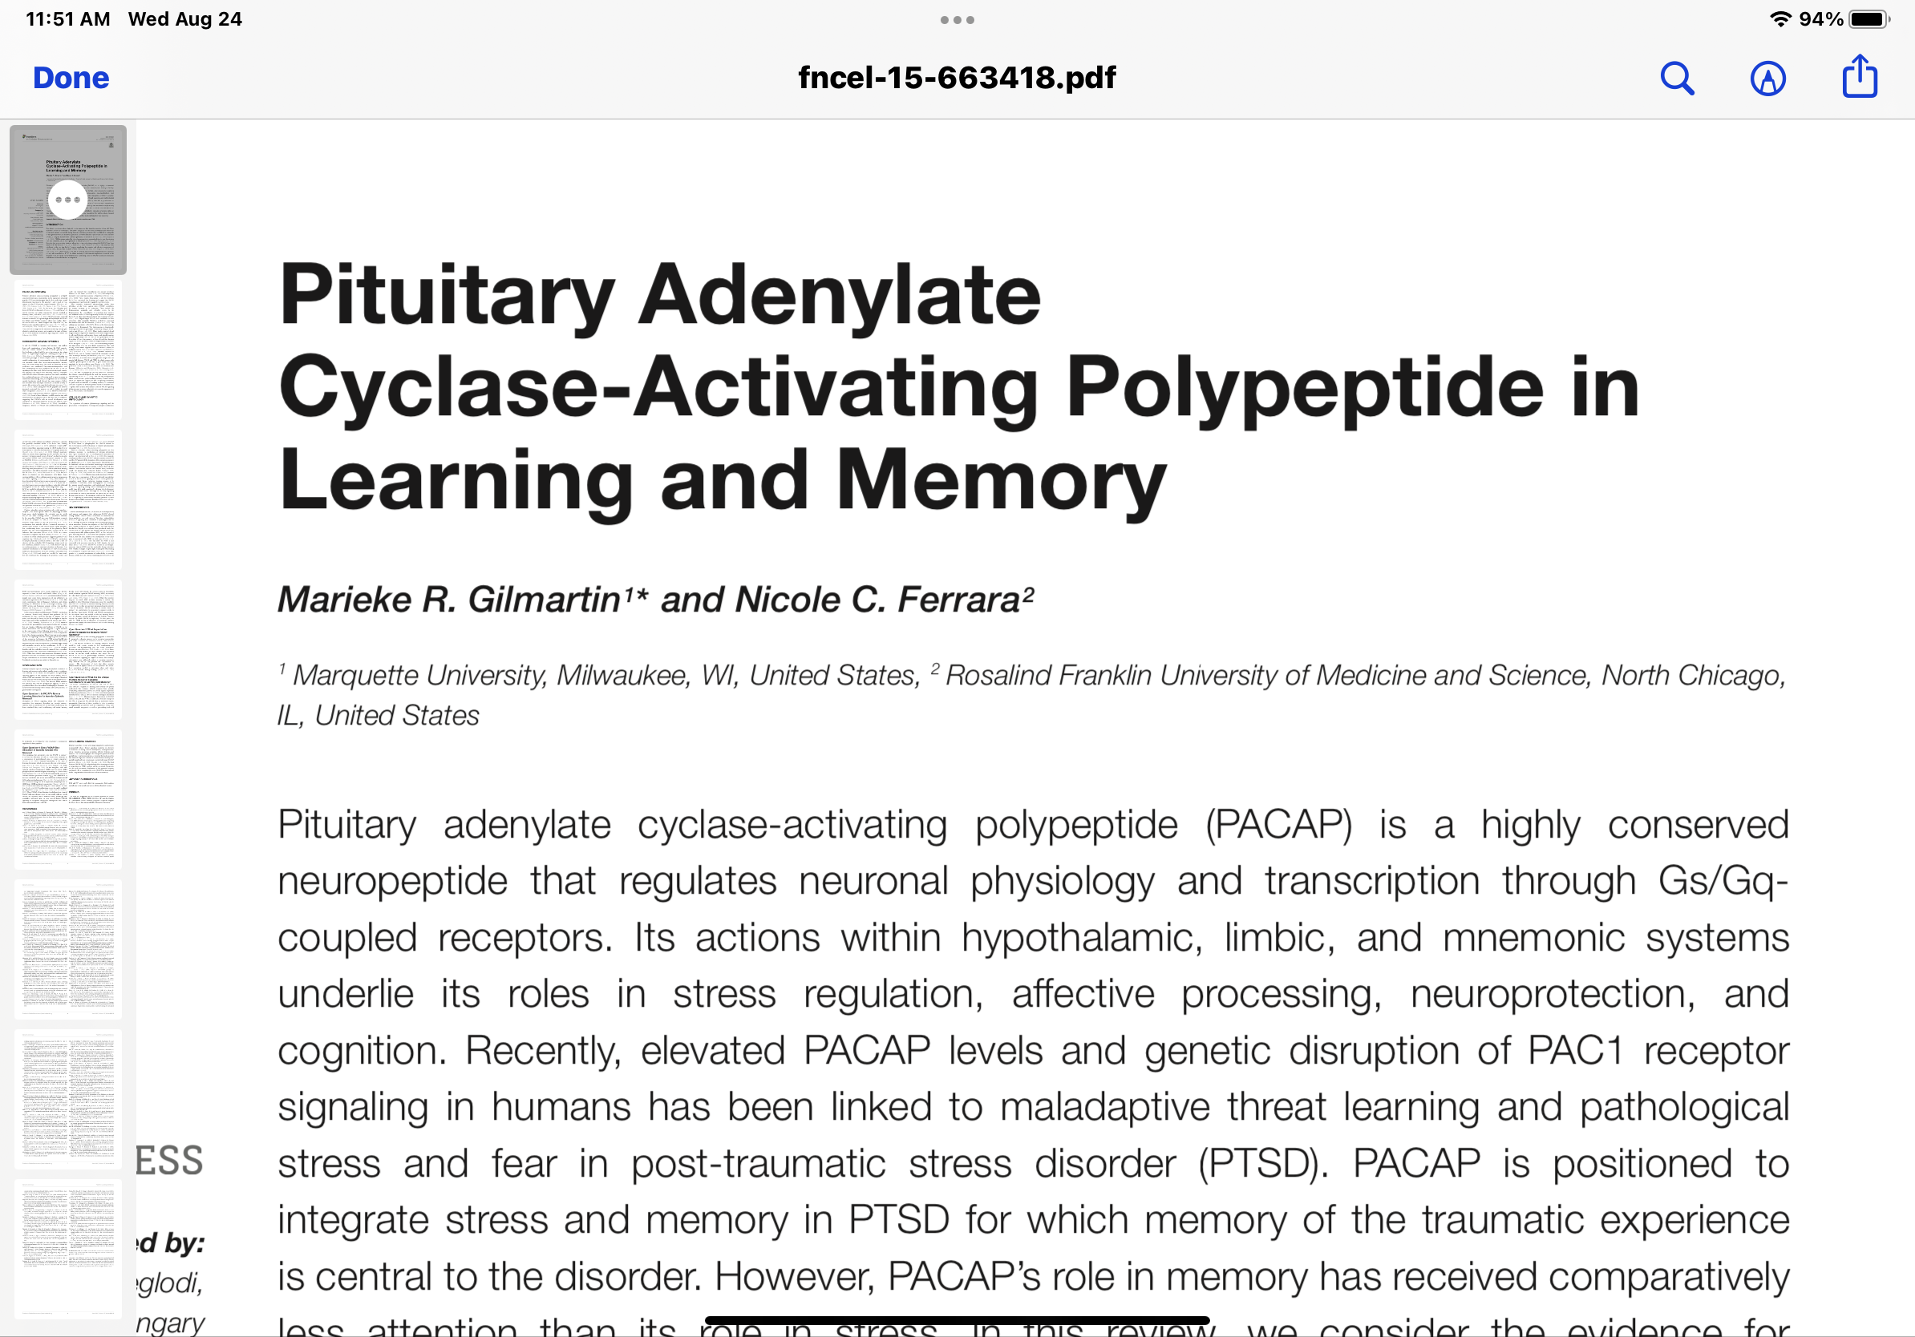
_______________________________________
PCAP regulates neural transcription within the hypothalamus, limbic system and mnemonic system.
It also has a role in stress regulation, affective processing, and cognition.

Slide 29
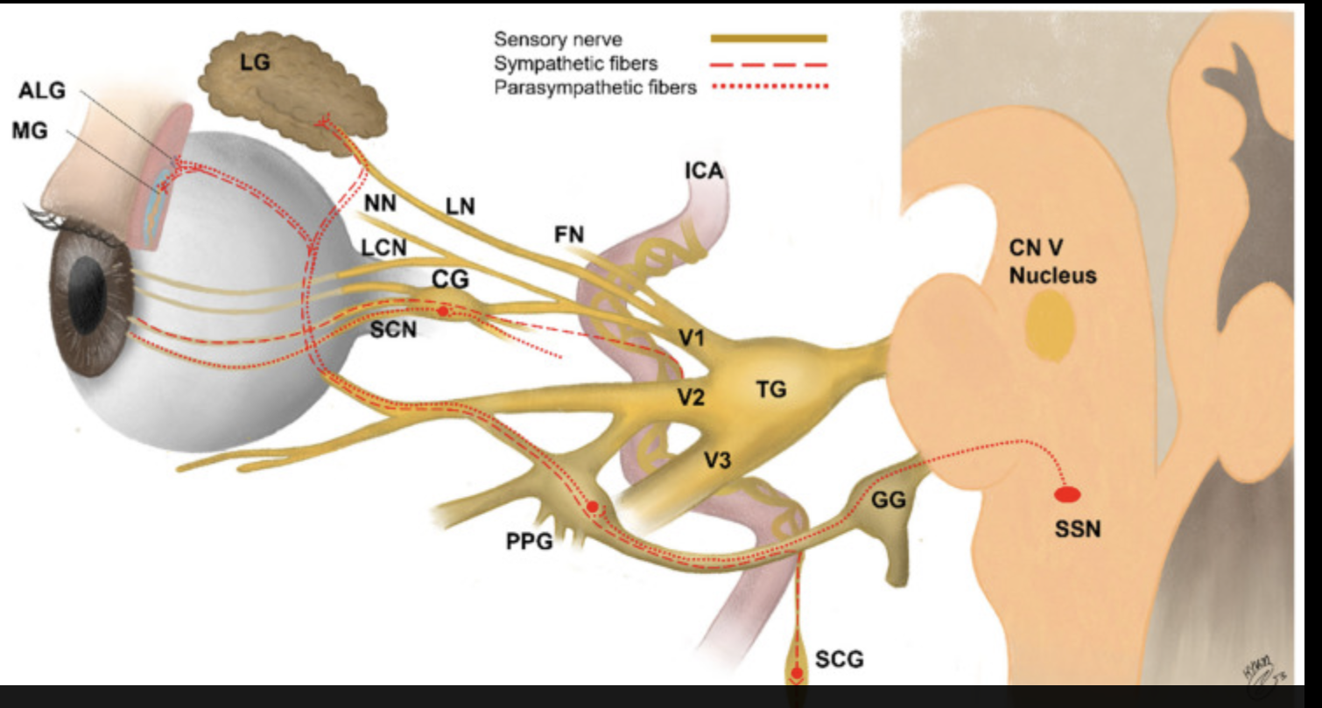
The Sensory and Parasympathetic fibers from the lacrimal gland pass through the trigeminal nerve where they are influenced by CGRP and PACAP.

Slide 30
Summary – 1:
__________________________
There is a high frequency of migraine in SjD patients.
The recognition of CGRP has revolutionized therapy of migraine.
The recognition of PACAP has started a search for new therapies.

Slide 31
Summary – 2:
__________________________
The mechanisms underlying the vascular (CGRP)
and pain threshold (PACAP)
may serve to explain
why the SjD patient’s symptoms correlate so poorly
with our objective measurement of dryness.
The PACAP may help the SjD patient’s
flares of reported symptoms with stress.

Slide 32
Summary – 3:
__________________________
As we are designing our EPIC EMR templates now, it will very hard to retroactively change the data collected— thus --
  We may need to start RECORDING migraine frequency and migraine medication use in our SjD patients now.
Migraine is a major factor in the Quality of Life of the SjD patient-- and we do not ask them routinely about this symptom… but need to start inquiring about it.

Slide 33

The Danger Hypothesis

Slide 34
The Immune System is the “6th sense.”
__________________________
The Danger Hypothesis was first proposed by Matzinger and colleagues at Salk Research Institute in La Jolla (San Diego), CA
back in 1994.
  It combines the Vascular, Endocrine and Immune systems in a single coherent system.

Slide 35

The Salk Research Institute
at Summer Solstice

Slide 36
The Danger Hypothesis –
(Matzinger et al, 1994)
Ann. Rev Immunol 12:991-1045
__________________________
The “Danger Hypothesis” is the underlying concept necessary to view immune-mediated pathogenesis and its relation to the autonomic nervous system.
The brain sends out lymphocytes as mobile sensors to detect “danger” signals from the periphery and report back to the brain.
  This involves both the innate and acquired immune systems.
Danger signals may include viruses and bacteria (including the biome), and adjust important functions including lacrimation and salivation.

Slide 37
Central Nervous System
Genetics
Environment
(the gut-immune axis)
Innate immune system encoded to respond to recurring Motiffs (TLRs)
Acquired immune system that can use mutation to select
high immunity B- and T-cells.

Slide 38
Time does not permit more detail
but all slides of this talk are posted on my educational website
for the benefit of both SjD patients and physicians
http://www.RobertFoxMD.com
Thank you
for the opportunity to remotely present at the
15th International Symposium on Sjögren's Disease.

Slide 41
Pituitary adenylate cyclase-activating polypeptide is a highly conserved pleiotropic neuropeptide in the vasoactive intestinal peptide (VIP)/secretin/glucagon family that modulates several physiological functions in the periphery and central nervous system
In the brain, the 38-amino acid form of PACAP predominates and its receptors are widely expressed in circuits involved in memory, stress, and affect
PACAP modulates neuronal function via the PACAP-specific high-affinity receptor PAC1 and the VPAC1 and VPAC2 receptors, which have similar affinity for PACAP and VIP.
Condro et al., 2016).
(Shioda et al., 1997; Hannibal, 2002; Joo et al., 2004;

Slide 42
What is a migraine?
The initial step is the aura with visual “starbursts”
The process starts in the intracranial meninges and affects the visual cortex since the retina exam remains normal
The meningeal irritation leads to the sensitization of trigeminal meningeal nociceptors which enter the thalamus to cause vasodilation and headache
(Migraine pain, meningeal inflammation, and mast cells)
Dan Levy, DOI: 10.1007/s11916-009-0040-y

Slide 43
Response to therapy indicates an inflammatory cause of migraine
Oral non-steroid anti-inflammatory drugs (NSAIDS) with ability to abort acute migraine headaches.
Corticosteroids also can abort migraines
Common triggers include foods (i.e., the biome), stress, and hormonal changes (all which are relevant in Sjogren’s

Slide 44
The CGRP diffuses across the blood-brain barrier and causes vasodilation and headache

